Slide 1
Pipelining and vector processing

Slide 2
Parallel processing
Number of processors attached in a system that process simultaneously
Increases the throughput of the system
Throughput is the amount of processing that can be completed within a certain time frame
Concurrent processing of data
Expensive technique due to high hardware requirements

Slide 3
Parallel processing
Example: When the ALU is performing operation on some data, at the same time next instruction can be fetched from the memory
It can be achieved by having multiple functional units that perform same or different operation simultaneously.

Slide 4
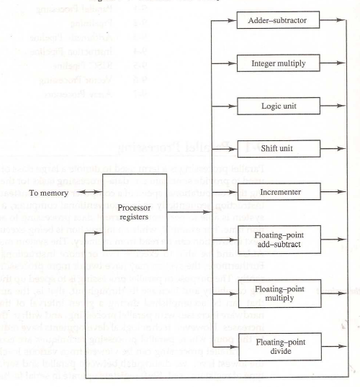
Parallel processing
Fig: processor with multiple functional units

Slide 5
Flynn’s classification of computers
SISD(Single Instruction Single Data)
uniprocessor
SIMD(Single Instruction Multiple Data)
Vector processor, array processor
MISD(Multiple Instruction Single Data)
MIMD(Multiple Instruction Multiple Data)
SMP, NUMA, cluster

Slide 6

SISD(Single Instruction Single Data)
Computers having single processing unit, control unit and memory unit
Instructions are executed sequentially
Only way of achieving parallel processing through pipeline processing

Slide 7
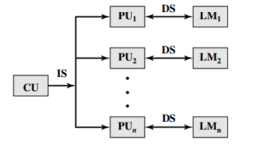
SIMD(Single Instruction Multiple Data)
Consists of many processing unit under the control of same control unit
All the processors receive the same instruction but the data they operate upon is different

Slide 8
MISD(Multiple Instruction Single Data)
Multiple instructions operate on the same data
Limited only to the theoretical aspect
Has no practical implication

Slide 9
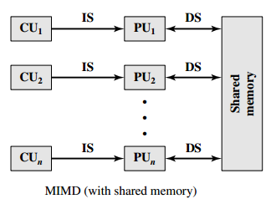
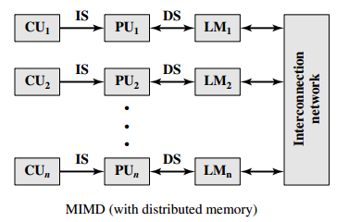
MIMD(Multiple Instruction Multiple Data)
Computer system that has the capability of performing several programs simultaneously
Eg: computers having multiple processors

Slide 10
Contd..
Pipelining is one of the type of parallel processing which does not fit under the flynn’s classification.
Only two categories SIMD and MIMD are used.

Slide 11
Techniques for achieving parallel processing
Pipelining
Replications

Slide 12
Pipelining
It is a technique of decomposing sequential process into sub-operation, with each sub-process is assigned to a dedicated segment that operates concurrently with all other segments.
Pipeline is a collection of processing segments through which binary information flows
Each segment performs partial processing according to the subtask that is assigned
The result of one segment is transferred to another segment
The final result after all the segments have completed

Slide 13
Pipelining contd..
Several computations are being performed in different segments simultaneously
Each segments are associated with a register which makes pipelining possible
Any operation that can be decomposed into a sequence of sub-operations of about the same complexity can be implemented by a pipeline processor.

Slide 14
Pipelining example
Example: A_{i}*B_{i}+C_{i} for i = 1, 2, 3,……,7
Instructions are pipelined as:
R1<- A_{i} and R2<-B_{i}
R3<-R1*R2, R4<-C_{i}
R5<-R3+R4
At every clock pulse the registers from R1 to R5 receive new data. Multiplier and adder are combinational circuits which perform multiplication and addition respectively.

Slide 15
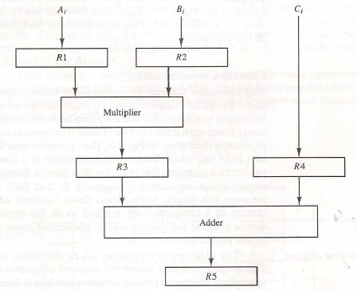
Pipelining
Fig: example of pipelining

Slide 16
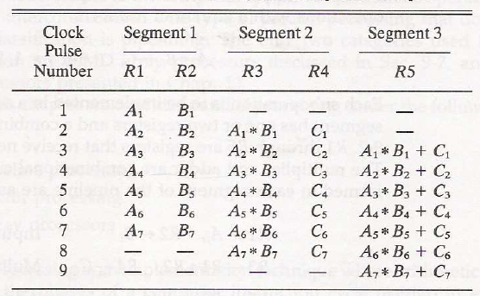
Pipelining

Slide 17
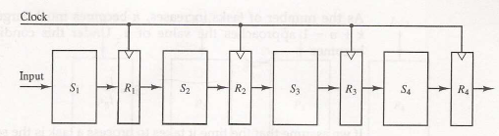
Basic structure of pipelining
Fig: four segment pipeline

Slide 18
Basic structure of pipelining contd…
The operands pass through all the four segments in a fixed sequence
The segments are separated through the registers that hold the intermediate results between the stages

Slide 19
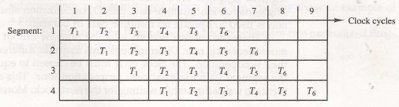
Basic structure of pipelining contd…
Fig: space time diagram for pipeline

Slide 20
Derivation of speed up ratio of pipeline over non pipeline system
Suppose a k-segment pipeline with a clock cycle time t_{p} is used to execute n tasks.
The first task T₁ requires a time equal to kt_{p} to complete its operation.
The remaining n-1 tasks will be completed after a time equal to (n-1)t_{p}
Therefore, to complete n tasks using a k-segment pipeline requires k+(n-1) clock cycles.

Slide 21
Contd..
Consider a non pipeline unit that performs the same operation and takes a time equal to t_{n} to complete each task. Then total time required for n tasks in nt_{n}
The speedup of a pipeline processing over an equivalent non-pipeline processing is defined by the ratio S= nt_{n} / (k+n-1)t_{p} .
If n becomes much larger than k-1 [(n+k-1) approaches to n if n>> k-1], the speedup becomes S= nt_{n} / nt_{p} = t_{n} / t_{p}

Slide 22
Contd..
If we assume that the time it takes to process a task is the same in the pipeline and non-pipeline circuits, ie. t_{n} =kt_{p} , the speedup reduces to S=kt_{p}/t_{p} = k
This shows that the theoretical maximum speed up that a pipeline can provide is k, where k is the number of segments in the pipeline.
But pipeline cannot operate at its maximum theoretical rate because of the following reason:
Different segments may take different times to complete their sub operation
The clock cycle must be chosen to equal the time delay of the segment with the maximum propagation time which cause the other segments to waste time while waiting for the next clock

Slide 23
Numerical example
Let the time it takes to process a sub-operation in each segment be equal to tp = 20 ns.
Assume that the pipeline has k = 4 segments and executes n = 100 tasks in sequence.
The pipeline system will take
(k + n - 1)t_{p} = (4+ 99) x 20 = 2060 ns to complete.
Assuming that t_{n} = kt_{p} = 4 x 20 = 80 ns, a non pipeline system requires nkt_{p} = 100 x 80 = 8000 ns to complete the 100 tasks.
The speedup ratio is equal to 8000/2060 = 3.88.
As the number of tasks increases, the speedup will approach 4, which is equal to the number of segments in the pipeline

Slide 24
..contd
Suppose that the time delays of the four segments are t₁= 60 ns, t₂ = 70 ns, t₃ = 100 ns, t₄ = 80 ns, and the interface registers have a delay of t_{r} = 10 ns.
The clock cycle is chosen to be t_{p} = t₃ + t_{r}= 110 ns (time req. to execute one sub operation) (for pipeline processor).
An equivalent non pipeline Processor will have a delay time t_{n} = t₁ + t₂ + t₃ + t₄ + t_{r} = 320 ns. (Time req. to execute one task)
In this case the pipelined adder has a speedup of 320/110 = 2.9 over the non pipelined adder. (Assuming n>>k-1)

Slide 25
Questions
A non-pipelined system takes 200ns to process task. The same task can be processed in a five-segment pipeline with a clock cycle of 40ns. Determine speedup ratio of the pipeline for 200 tasks. What is the maximum speed up that could be achieved with the pipeline unit over the non-pipelined unit?
A non-pipelined system takes 100ns to process task. The same task can be processed in a five-stage pipeline with a clock cycle of 20ns. Determine speedup ratio of the pipeline for 100 tasks. What is the theoretical speed up that could be achieved with the pipeline unit over the non-pipelined unit?
Consider a pipeline system with 10 segment, if each segment requires 10ns to process sub-operation then find the total time requires to completely execute 500 task. Also determine speed up ratio of pipeline system over equivalent non pipeline system.
Suppose that a pipeline system with 6 segment each requires 10ns, 30ns, 40ns, 5ns, 15ns and 50ns respectively to process sub-operation. If the number of task is 100 then find the total time requires to execute all task by pipeline system. Also determine speed up ratio of pipeline system over equivalent non pipeline system.
Time take to complete a task in conventional machine is 45ns. In pipelined machine, one task is divided into 5 segments and each sub-operation takes 10ns. Calculate pipeline speed up for 50 tasks and infinite task.

Slide 26
Types of pipeline
Pipelines usually divided into two classes:
Arithmetic pipeline
Divides an arithmetic operation into sub operations for execution in the pipeline segments.
Instruction pipeline
Operates on a stream of instructions by overlapping the fetch, decode, and execute phases of the instructions cycle

Slide 27
Arithmetic pipeline
Divides an arithmetic operation into sub operations for execution in the pipeline segments.
Usually found in very high speed computers.
Used to implement Floating-point operations, multiplication of fixed –point numbers, and similar computations in scientific problem.

Slide 28

Arithmetic pipeline example (Contd..)
Considering a pipeline unit for floating point addition and subtraction
The inputs to the floating-point adder pipeline are two normalized floating-point binary numbers
Where A and B are two fraction that represent the mantissa and a and b are the exponent.

Slide 29
Arithmetic pipeline example (Contd..)
The floating-point addition and subtraction can be performed in four segments
The register labeled R are placed between the segments to store intermediate results
The sub-operation that are performed in four segments are:
Compare the exponents
Align the mantissas
Add or subtract the mantissas
Normalize the result

Slide 30
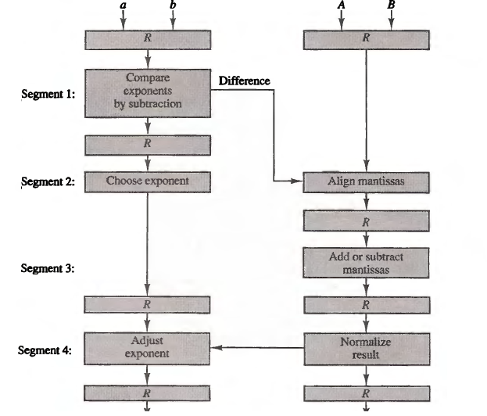
Contd..

Slide 31
Instruction pipeline
Reads consecutive instructions from memory while the previous instructions are being executed. This cause the instruction fetch and execute phases to overlap and perform simultaneous operations.
Drawback:
Incase of branch, all the instructions that have been previously loaded must be discarded

Slide 32
Instruction pipeline (Contd..)
Instruction cycle consists of 6 phases for complex instructions:
Fetch the instruction from the memory
Decode the instruction
Calculate the effective address
Fetch the operands from memory
Execute the instruction
Store the result in the proper place
There are certain difficulties that will prevent the instruction pipeline from operating at its maximum rate.
Different segments may take different times to operate on the incoming information
Some segments are skipped for certain operations.
Two or more segments may require memory access at the same time, causing one segment to wait until another is finished with the memory.

Slide 33
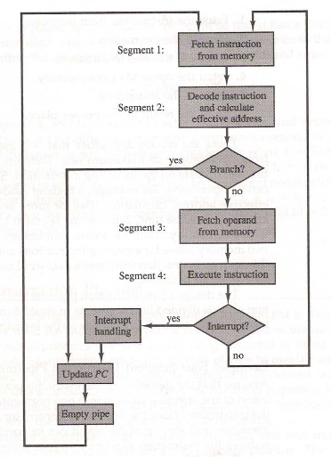
Instruction pipeline (E.g. : 4 segment instruction pipeline)
Fig: four segment instruction pipeline

Slide 34
Instruction pipeline (E.g. :4 segment instruction pipeline)
Segment 1:
FI segment fetches the instructions
Segment 2:
DA decodes the instruction and calculates the effective address
Segment 3:
FO fetches the operand
Segment 4:
EX executes the instruction and store the result.
[NOTE: in this example we assumed that the processor has separate instruction and data memories so that the operation in FI and FO can proceed at the same time.]

Slide 35
Instruction pipeline (E.g. :4 segment instruction pipeline)
When an instruction is being executed in segment 4, segment 3 is busy fetching the operands for the next execution. Similarly, segment 2 and segment 1 are busy decoding the effective address and fetching instruction respectively
Instruction 1 is being executed in segment 4, instruction 2’s operands are being fetched in segment 3, instruction 3’s effective address being calculated in segment 2 and instruction 4 being fetched from memory in segment 1
If there is branch or interrupt, the all segments have to be emptied

Slide 36
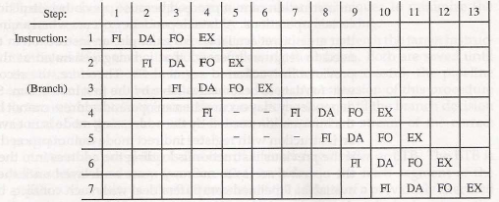
Instruction pipeline (E.g. :4 segment instruction pipeline)
Fig: timing of instruction pipeline

Slide 37
Pipeline hazards and their solution
Pipeline hazards:
Resource conflicts:
When two or more segments attempt to access the memory at the same time, a resource conflict occurs.
It can be resolved by using separate instruction and data memories

Slide 38
Pipeline hazards (Pipeline conflicts) and their solution
Data dependency:
Data dependency occurs when the instructions depend on the result of the previous instruction but the result is not available
Caused due to collision of data or address
A collision occurs when an instruction cannot complete because the previous instruction did not complete certain operations
Solutions of data dependency:
Hardware interlocks
Operand forwarding
Delayed load

Slide 39
Pipeline hazards and their solution
Hardware interlocks:
An interlocks is a circuit that detects instructions whose source operands are destinations of instructions farther up in the pipeline. Detection of this situation causes the instruction whose source is not available to be delayed by enough clock cycles to resolve the conflict. This approach maintains the program sequence by using hardware to insert the required delays.
Operand forwarding:
Uses special hardware to detect conflict . If there is a conflict, then the data is routed through special path to the destination
This method requires additional hardware paths through multiplexers as well as the circuit that detects the conflict.

Slide 40
Pipeline hazards and their solution
Delayed load:
If a conflict is detected, the instructions causing conflict are rearranged such that the conflicting instruction is delayed

Slide 41
Pipeline hazards and their solution
Branch difficulties:
It arises due there is branching of instructions or other instructions that change the value of the Program Counter (PC)
Solutions for branch instructions:
Pre-fetch target instruction
Branch target instruction
Loop buffer
Branch prediction
Delayed branch

Slide 42
Pipeline hazards and their solution
Pre-fetch target instruction:
Both the branching instruction and target instruction are determined and saved until branch is executed such that in case of branch instruction, the pipeline continues from branch target instruction

Slide 43
Pipeline hazards and their solution
Branch target buffer:
Also called BTB
It is an associative memory used to store address of previously executed branch instruction, target instruction of that branch and next few instructions after the branch target instruction
When a branch condition is meet, the associative memory is searched such that the branch target can be executed without any interruption

Slide 44
Pipeline hazards and their solution
Loop buffer:
Variation of BTB
When program loop is detected, it is stored in the loop buffer such that the execution can be done without any interruption
Branch prediction:
Here, the outcome of branch condition is predicted before it occurs, then the pipeline begins pre-fetching instructions from the predicted path

Slide 45
Pipeline hazards and their solution
Delayed branch:
Detection of branch condition and reorganizing the branch causing instructions in such a way that the appear at the end

Slide 46
Super computers
A commercial computer with vector instructions and pipelined floating-point arithmetic operations is referred to as a supercomputer.
Fast and special purpose computers
Huge storage capacity
High speed memory
Uses pipeline and vector processor
Components are placed in compact so the speed becomes high
First super computer is Cray-1(1976)

Slide 47
Super computers
Costly and rarely available in market
Used mostly in scientific applications, such as numerical weather forecasting, seismic wave analysis and space research etc.
Speed measured in terms of flops (floating point operations per second) and megaflops (millions of flops) or gigaflops (billons of flops)

Slide 48
Array processor
Processor that performs computations on large array of data
Used to perform array and vector processing
For example a processor needs to execute ten instructions each associated with five data items in order to perform a task. Scalar processor executes all the ten instructions with one data item and then moves to the next data while vector processors take the first instruction and execute it for all five data items and then move to next instruction.

Slide 49
Array processor
Types:
Attached Array Processor
An attached array processor is an auxiliary processor attached to a general-purpose computer. It is intended to improve the performance of the host computer in specific numerical computation tasks.
SIMD Array processor
An SIMD array processor is a processor that has a single-instruction multiple-data organization. It manipulates vector instructions by means of multiple functional units responding to a common instruction.

Slide 50
Attached array processor
Used in conventional host computer (general purpose computer)
Enhances performance by the means of vector processing and parallel processing
Satisfies the needs for complex arithmetic applications
In the figure, array processor is connected to general purpose computer through an input-output controller. Data for attached array processor are transferred from main memory to local memory

Slide 51
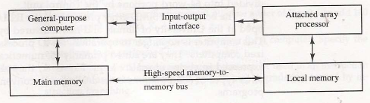
Attached array processor
Fig: attached array processor with host computer

Slide 52
SIMD array processor
Computer with multiple processing units operating in parallel
Processors are synchronized to operate under the same control unit
It’s figure consists of processing elements (PEs), each having a local memory M, master control unit and main memory
Each PE consist of ALU, floating-point arithmetic unit and working registers
Master control unit controls the operation of the PEs. Its function is to decode the instruction and execute it
Program control instructions and scalar instructions are handled by the master control unit while, vector instructions are handled by the PEs
Main memory is used for storage purpose

Slide 53
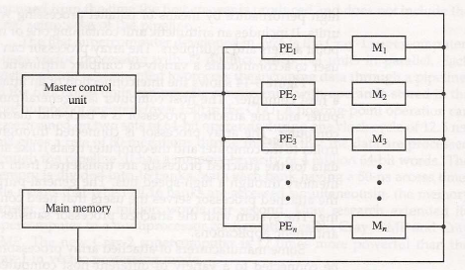
SIMD array processor
Fig: SIMD array processor organization

Slide 54
Vector processing
Capability of CPUs (computers) that can solve problems that are formulated in terms of vectors and matrices
Applications:
Weather forecasting
Seismic data analysis
Medical diagnosis
Aerodynamics and flight simulation
Long-range weather forecasting
Seismic data analysis
Artificial intelligence and expert systems

Slide 55
..Contd
To achieve the required level of high performance it is necessary to utilize the fastest and most reliable hardware and apply innovative procedures from vector and parallel processing techniques.

Slide 56
Vector Operations
Many scientific problems require arithmetic operations on large arrays of numbers.
A vector is an ordered set of a one-dimensional array of data items.
A vector V of length n is represented as a row vector by V = [V₁ ,V₂ ,V₃, • • V_{n}].
To examine the difference between a conventional scalar processor and a vector processor, consider the following Fortran DO loop:
DO 20 I = 1, 100
20 C(I) = B(I) + A(I)
A computer capable of vector processing eliminates the overhead associated with the time it takes to fetch and execute the instructions in the program loop.
C(1: 100) = A(1: 100) + B(1: 100)

Slide 57
Memory interleaving
Instruction pipeline may require fetching the instruction and operand the same time. Similarly, arithmetic pipeline generally requires two or more operands to enter the pipeline simultaneously.
In such cases, instead of using multiple memory buses, we partition the memory into a number of modules connected to common address bus and data bus.
A memory module is a memory array which has its own address and data register for each memory array
AR receives information from a common address bus whereas DR communicates with bi-directional data bus
2 LSBs of address distinguish between the four modules

Slide 58
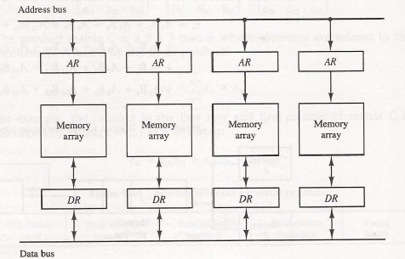
..Contd Memory interleaving
The system permits one module to initiate access whereas other modules can process reading and writing of word
Each module can honor a memory request independent of the state of other modules

